Slide 1

Learning Python
2020/10/12

Slide 2

Agenda:
Python List
Access List Items
Change List Items
Add list items

Slide 3
IMPORTANT NOTE:
Do not share this file.
Do not redistribute this file.
Do not sell this template.
Do not share the code with anyone. Let others follow the mechanics on YouTube for them to get this template.
If you have spare time, please leave a comment on YouTube that you already downloaded the file. Your simple words of appreciation will motivate me to create more free templates.
PYTHON LIST

Slide 4

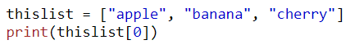
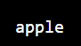

List
List are used to store multiple items in a single variable
List are one o the 4 built-in data types in python used to store collections of data, the other 3 are Tuple, Set, and Dictionary, all with different qualities and usage.
List are created using square brackets:

Slide 5

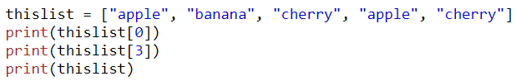

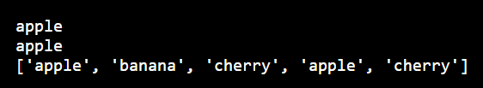
Changable
The list is changeable, meaning that we can change, add, and remove items in a list after it has been created.
Allow Duplicates
Since lists are indexed, lists can have items with the same value:

Slide 6
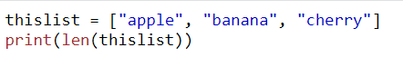
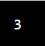
List Lenght
To determine how many items a list has, use the len() function:

Slide 7
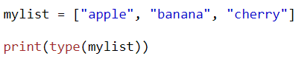
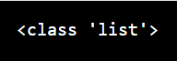
Type()
From python’s perspective, list are defined as objects with the data type ‘list’.

Slide 8
IMPORTANT NOTE:
Do not share this file.
Do not redistribute this file.
Do not sell this template.
Do not share the code with anyone. Let others follow the mechanics on YouTube for them to get this template.
If you have spare time, please leave a comment on YouTube that you already downloaded the file. Your simple words of appreciation will motivate me to create more free templates.
ACCESS LIST ITEMS

Slide 9

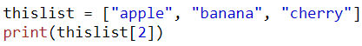
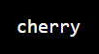
Access Items
List items are indexed and you can access them by referring to the index number:

Slide 10


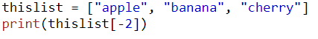
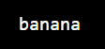
Negative indexing:
Negative indexing means start from the end -1 refers to the last item, -2 refers to the second last item etc.

Slide 11
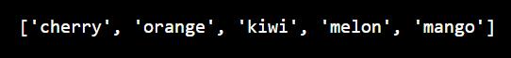
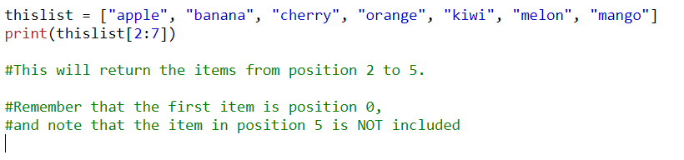
Range of Indexes
You can specify a range of indexes by specifying where to start and were to end the range.
When specifying a range, the return value will be new list with specified items.

Slide 12
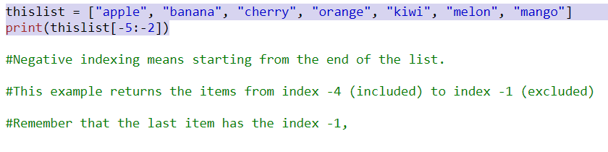
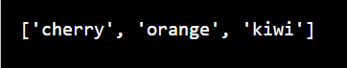
Rage of Negative Endexes:
Specify negatives indexes if you want to start the search from the end of the list:

Slide 13

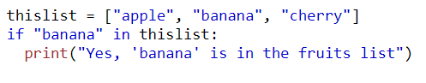
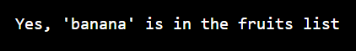
Check if Items Exists:
To determine if a specified item is present in a list use the in keyword:

Slide 14
IMPORTANT NOTE:
Do not share this file.
Do not redistribute this file.
Do not sell this template.
Do not share the code with anyone. Let others follow the mechanics on YouTube for them to get this template.
If you have spare time, please leave a comment on YouTube that you already downloaded the file. Your simple words of appreciation will motivate me to create more free templates.
CHANGE LIST ITEMS

Slide 15
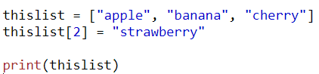
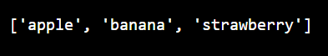
Change Item Value:
To change the value of a specific item, refer to the index number:

Slide 16
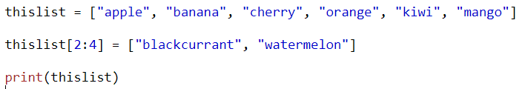
Change a Range of Item Values
To change the value of items within a specific range, define a list with the new values, and refer to the range of index numbers where you want to insert the new values:

Slide 17
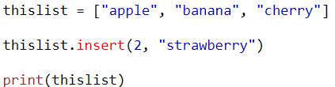
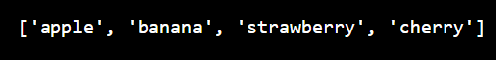
Insert Items:
To insert a new list item, without replacing any of the existing values, we can use the insert() method
The insert() method inserts an item at the specified index:

Slide 18
IMPORTANT NOTE:
Do not share this file.
Do not redistribute this file.
Do not sell this template.
Do not share the code with anyone. Let others follow the mechanics on YouTube for them to get this template.
If you have spare time, please leave a comment on YouTube that you already downloaded the file. Your simple words of appreciation will motivate me to create more free templates.
ADD LIST ITEMS

Slide 19
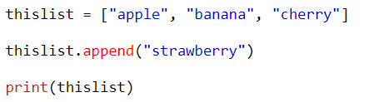
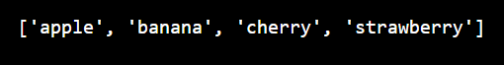
Append Items:
To add an item to the end of the list, use the append() method:

Slide 20
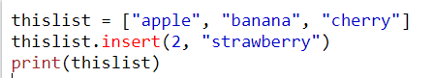
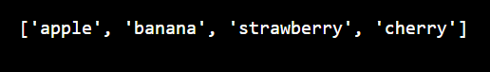
Insert Items
To insert a list item at a specified index, use the insert() method.
The insert() method inserts an item at the specified index:

Slide 21
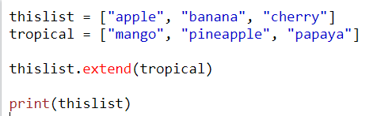
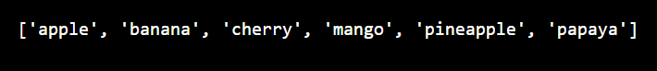
Extend List:
To append elements from another list to the current list, use the extend() method.

Slide 22
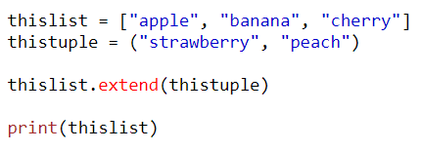
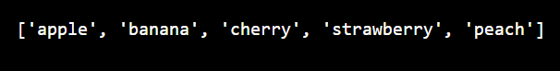
Add Any Iterable:
The extend() method does not have to append list, you can add any iterable object(tuples, sets, dictionaries etc.)

Slide 23

THANK YOU
CHINESE NAME: 錢德羅
STUDENT ID: 4110E216
ENGLISH NAME: Chandro S. Ermitanio
EMAIL: chandroermitanio95@gmail.com
GITHUB: https://github.com/4110e216/cs2022.git

